Slide 1
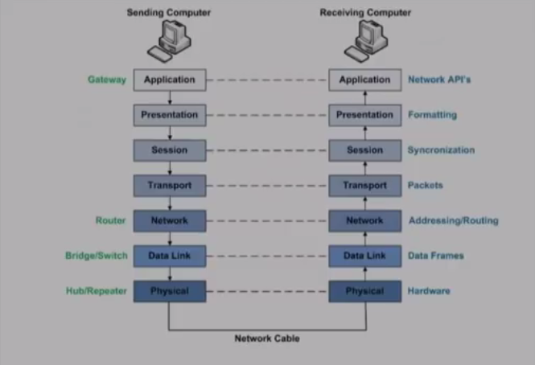

Slide 2
Layered Task
A network is a combination of hardware and software that send data from one location to another.
The hardware consists of physical equipment that carries signals from one point of the network to another.
The software consists of instruction sets that make possible the services that we expect from a network.

Slide 3
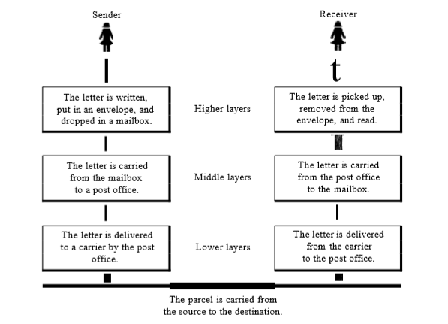
Layered Task(Cont.)
For example let us consider who communicate through postal mail.
The process of sending a letter to a friend would be complex if there were no services available from the post office.
The following figure shows the tasks involved in sending a letter.

Slide 4
Sender, Receiver and Carrier
Activities that take place at the sender site.
- Higher layer : The sender writes the letter, inserts the letter in the envelope, writes the sender and receiver addresses, and drops the letter in the mailbox.
- Middle layer : The letter is picked up by a letter carrier and delivered to the post office.
- Lower layer : The letter is sorted at the post office and a carrier transports the letter.
On the way
The letter is then on its way to the recipient. On the way to the recipients local post office, the letter may actually go through a central office. In addition it may be transported by truck, train, airplane, boat or a combination of these.

Slide 5
Sender, Receiver and Carrier(Contd).
Activities at the receiver site:
-Lower layer : The carrier transports the letter to the post office.
- Middle layer : The letter is sorted and delivered to the receipients mailbox.
-Higher layer : The receiver picks up the letter, Opens the envelope and reads it.
Analysis Based on hierarchy :
- 3 activities at sender site
- 3 activities at receiver site
The task of transporting the letter between the sender and receiver is done by the carrier.
We notice the tasks must be done in the order given in the hierarchy.
Each layer at the sending site uses the services of the layer immediately below it.
-The sender at the higher layer uses the services of the middle layer.
-The middle layer uses the services of lower layer.
-The lower layer uses the services of the carrier.

Slide 6
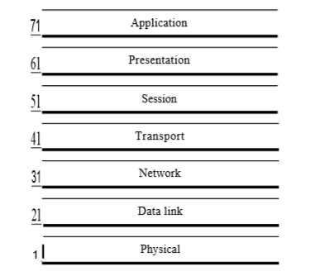
Layers in OSI model

Slide 7
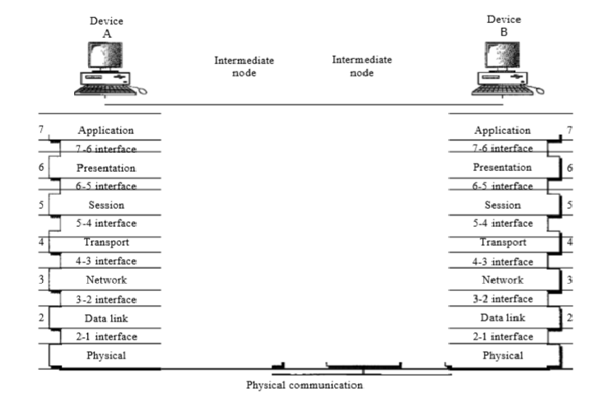
Interfaces between layers in OSI model

Slide 8
Interfaces between layers in OSI model.
The passing of the data and network information down through the layers of the sending device and back up through the layers of the receiving device is made possible by an interface between each pair of adjacent layers.
Each interface defines the information and services a layer must provide for the layer above it.
Well defined interfaces and layer functions provide modularity to a network.

Slide 9
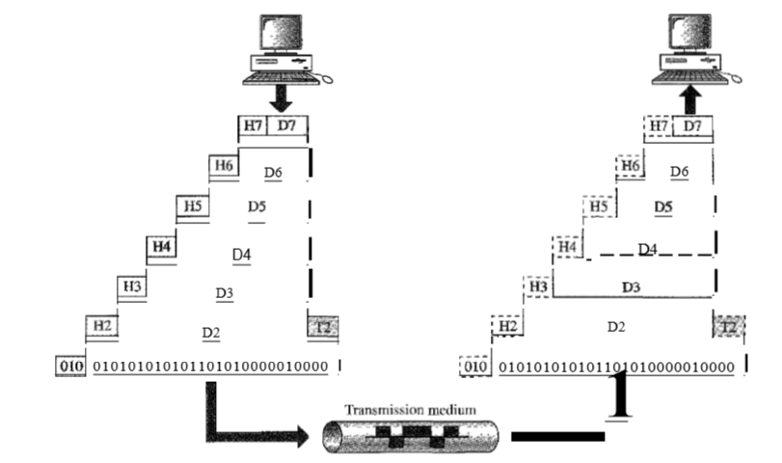
Overall view of OSI model

Slide 10
Overall view of OSI model
D7 means data unit at layer 7, D6 means data unit at layer 6 and so on.
The process starts at layer 7(the application layer), then moves from layer to layer in descending, sequential order.
At each layer a header, or possibly a trailer, can be added to the dat unit.
When the formatted data unit passes through the physical layer(layer 1) it is changed into the electromagnetic signal and transported along a physical link.
Upon reaching its destination, the signal passes into layer 1 and is transformed back into digital form.
The data units the move back up through the layers.
As each block of data reaches the next higher layer, the headers and trailer attached to it at the corresponding sending layer are removed, and actions appropriate to that layer are taken.
By the time it reaches layer 7, the message is again in the form appropriate to the application and is made available to the recipient.

Slide 11
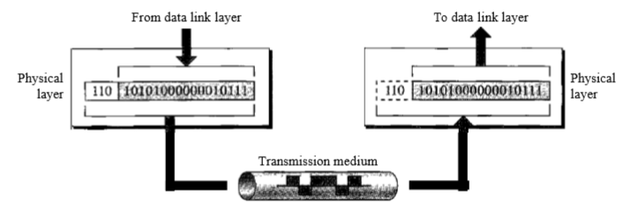
Physical Layer – Layer 1
is responsible for movements of individual bits from one hop(node) to next.
Other responsibilities includes the following.
Physical Characteristics of interfaces and medium
Representation of bits
Data rate
Synchronization of bits
Line configuration
Physical topology
Transmission mode.

Slide 12
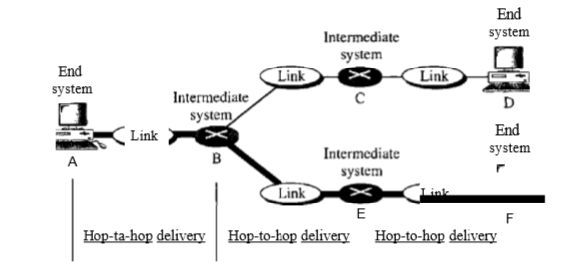
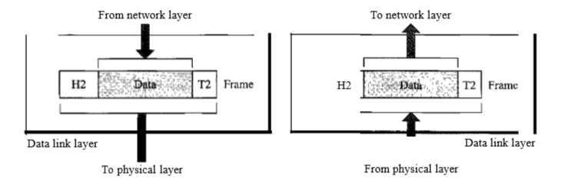
Data Link Layer – Layer 2
The data link layer is responsible for moving frames from one hop(node) to next.
Other responsibilities includes the following
Framing
Physical addressing
Flow control
Error control
Access control

Slide 13
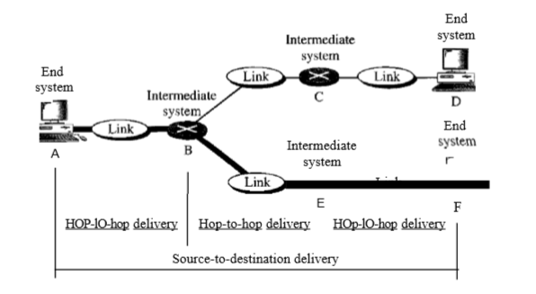
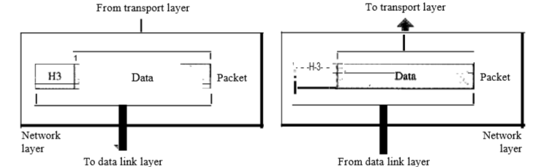
Network Layer – Layer 3
Is responsible for the delivery of individual packets from the source host to the destination host.
Other responsibilities includes
Logical addressing
Routing

Slide 14
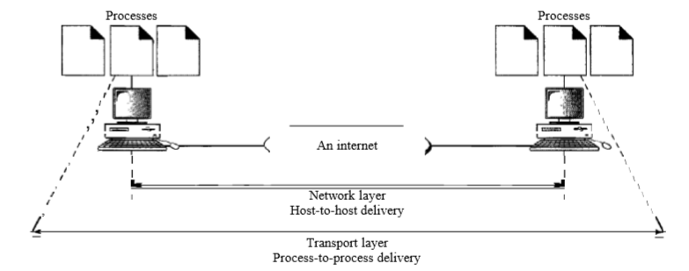
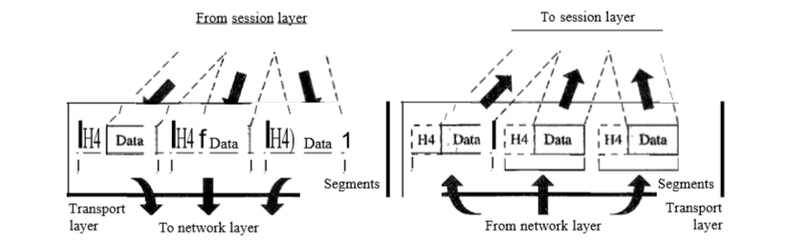
Transport Layer – Layer 4
Is responsible for the delivery of a message from one process to another.
Other responsibilities includes
Service-Point Addressing
Segmentation and reassembly
Connection control
Flow control
Error control

Slide 15
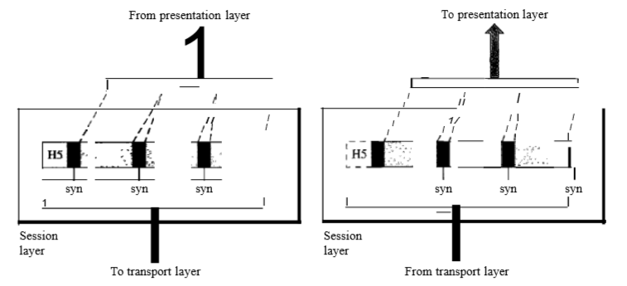
Session Layer – Layer 5
Is responsible for dialog control and synchronization
The service provided by the first three layers are not sufficient for some processes.
It is the network dialog controller.
It establishes, maintains and synchronizes the interaction among communicating systems.
Dialog Control : Allows two systems to enter into a dialog. It allows communication between two processes to take place either in half duplex(one way at a time) mode or full duplex(two ways at a time) mode.
Synchronization : It allows a process to add check-points or synchronization points to a stream of data.
For example if a stream is sending a file of 2000 pages and it adds checkpoints at every 100 pages. If a crash happens during the transmission of page 523, the only pages that need to be resent after system recovery are pages from 501 to 523

Slide 16
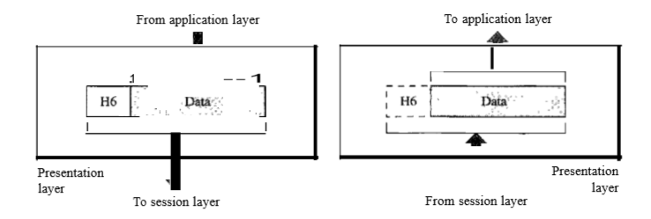
Presentation Layer – Layer 6
Is responsible for
translation,
compression and
encryption.

Slide 17
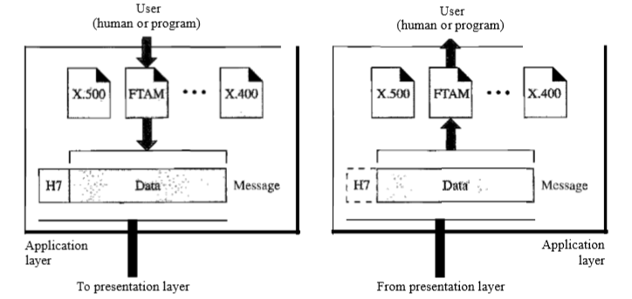
Application Layer – Layer 7
Is responsible for providing services to the user.
It enables the user, whether human or software, to access the network
Specific services provided by application layer are
Network virtual terminal – software version of physical terminal and it allows a user to log on to a remote host
File transfer, access and management
Mail services
Directory services

Slide 18
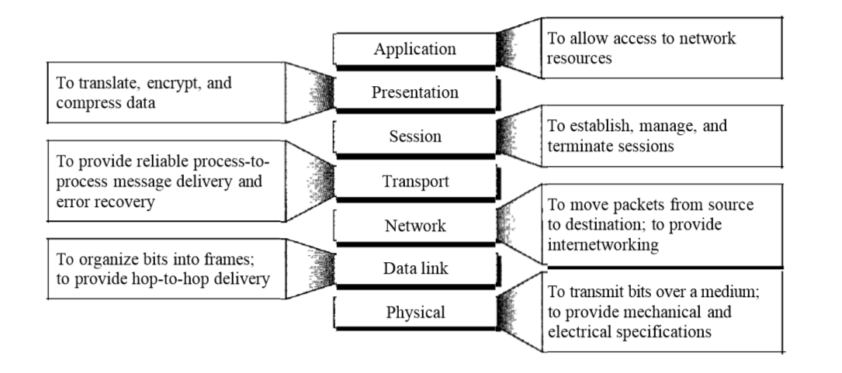
Summary of Layers

Slide 19
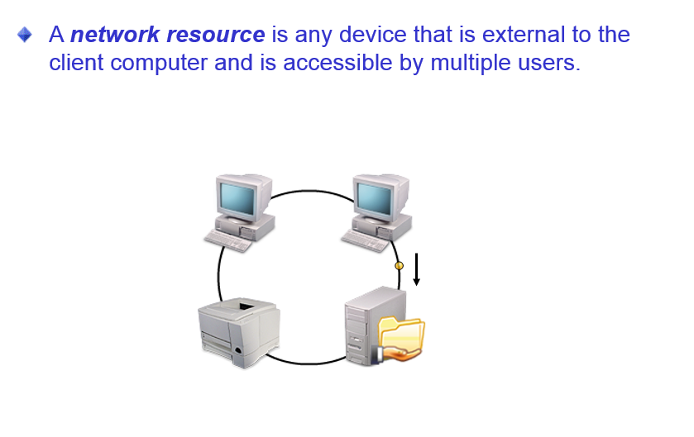
Network Resources

Slide 20
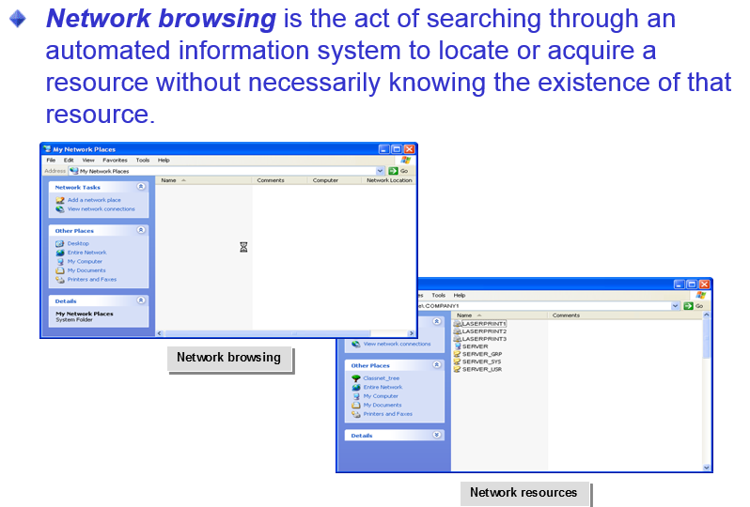
Network Browsing

Slide 21
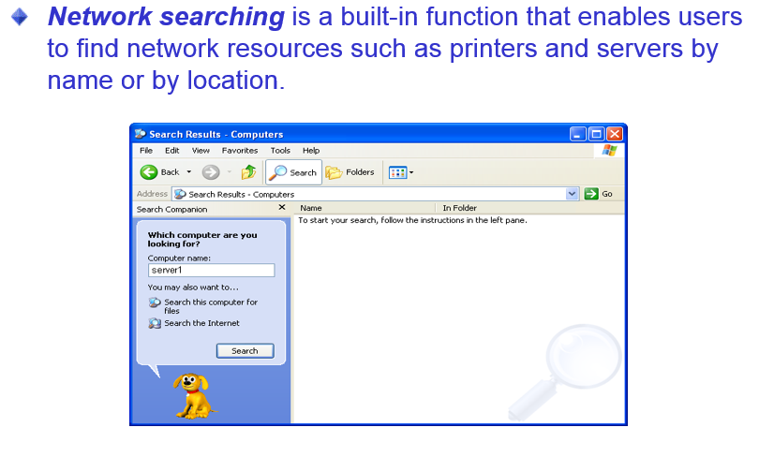
Network Searching

Slide 22
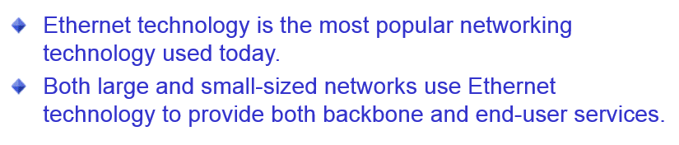
Ethernet Networks

Slide 23
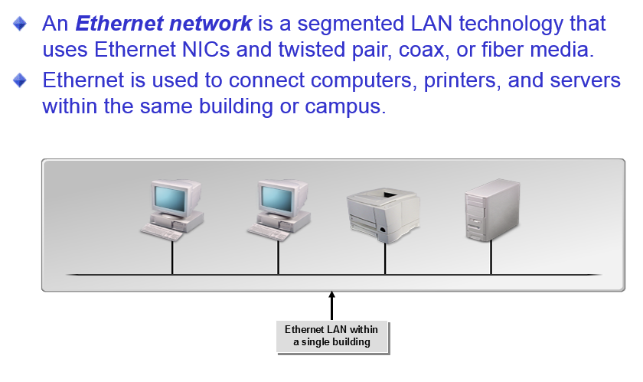
Ethernet

Slide 24
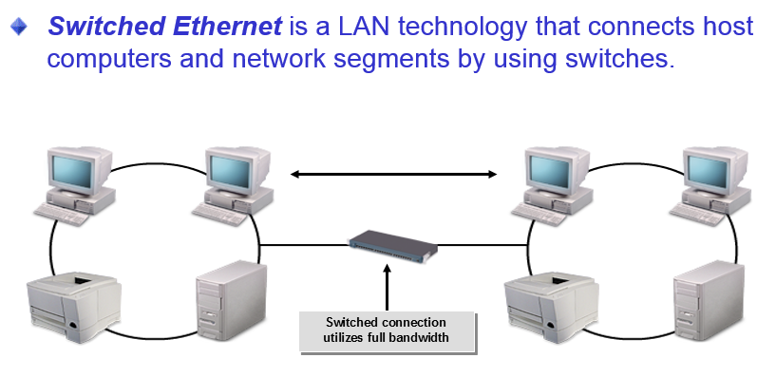
Switched Ethernet

Slide 25
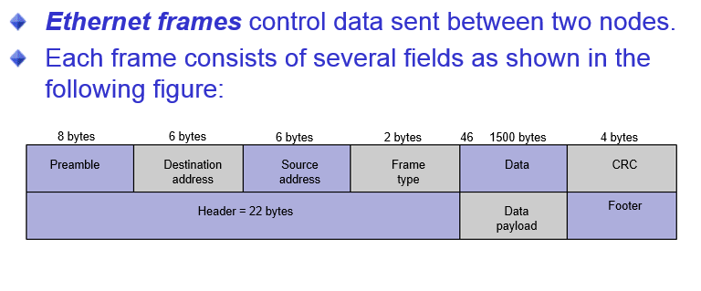
Ethernet Frames

Slide 26
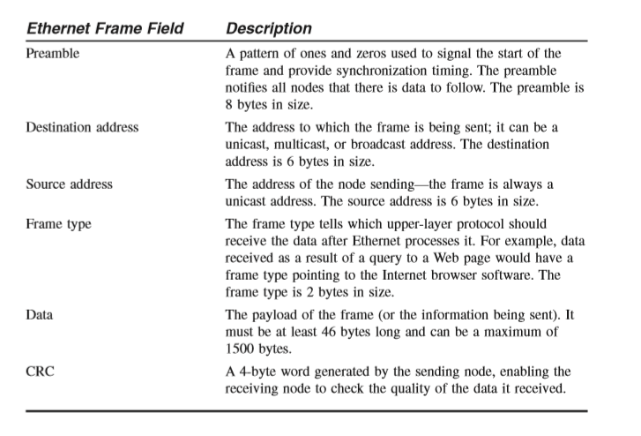
Ethernet Frames

Slide 27
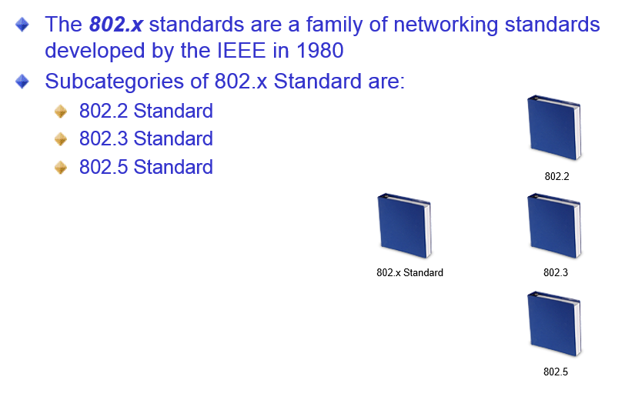
The IEEE 802.x Standard

Slide 28
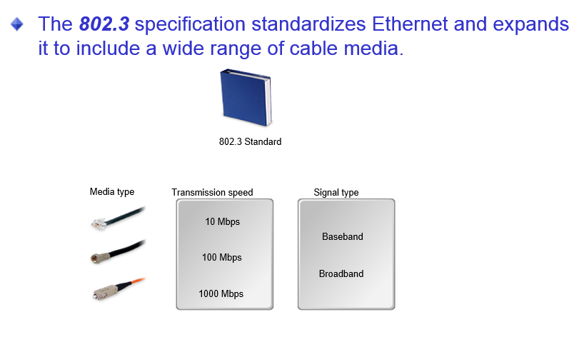
802.3 Standards

Slide 29
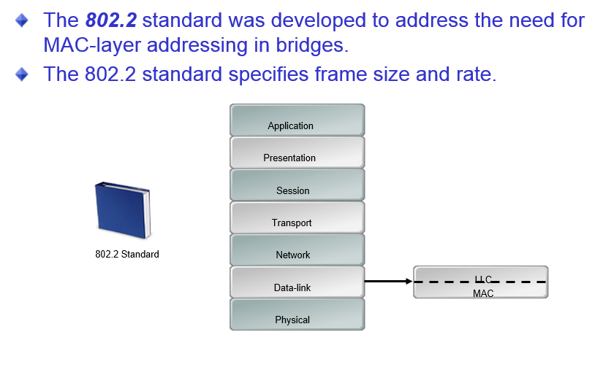
802.2 Standards

Slide 30
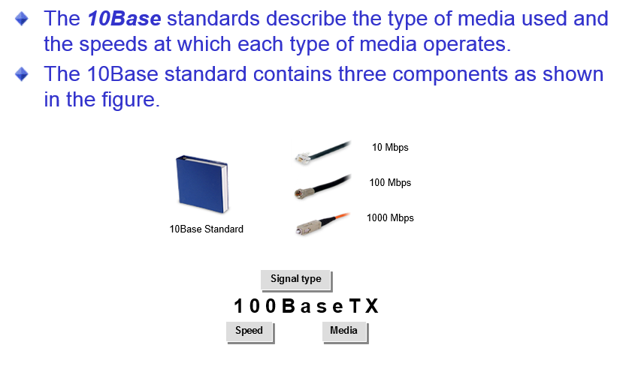
The 10Base Standards

Slide 31
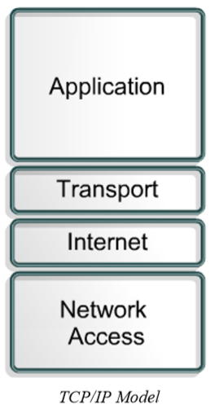
TCP/IP Model
The U.S. Department of Defense (DOD) created the TCP/IP reference model because it wanted a network that could survive any conditions

Slide 32
Protocols used in TCP/IP
FTP : File transfer protocol is a reliable, connection oriented service that uses TCP to transfer files between systems that support FTP.
TFTP : Trivial File Transfer Protocol is a connectionless service that uses the User Datagram Protocol (UDP)
NFS : Network File System is a distributed file system protocol suite developed by Sun Microsystems that allows file access to a remote storage device such as a hard disk across a network.
SMTP : Simple Mail Transfer Protocol administers the transmission of e-mail over computer networks. It does not provide support for transmission of data other than plain text.
Telnet : Telnet provides the capability to remotely access another computer. It enables a user to log into an Internet host and execute commands. A Telnet client is referred to as a local host. A Telnet server is referred to as a remote host
SNMP : Simple Network Management Protocol is a protocol that provides a way to monitor and control network devices. SNMP is also used to manage configurations, statistics, performance, and security
DNS : Domain Name System is a system used on the Internet to translate domain names and publicly advertised network nodes into IP addresses

Slide 33
Application Layer
It handles high-level protocols, representation, encoding and dialog control.
The TCP/IP protocol suite combines all application related issues into one layer
It ensures that the data is properly packaged before it is passed on to the next layer

Slide 34
Transport Layer
The transport layer provides a logical connection between a source host and a destination host
Transport protocols segment and reassemble data sent by upper-layer applications into the same data stream, or logical connection, between end points
Creates packet from bytes stream received from the application layer
Uses port number to create process to process communication
Uses a sliding window protocol to achieve flow control
Uses acknowledgement packet, timeout and retransmission to achieve error control
Transport layer protocols include TCP and UDP.

Slide 35
TCP – Transmission Control Protocol
TCP is a connection-oriented transport layer protocol that provides reliable full-duplex data transmission
TCP is part of the TCP/IP protocol stack
In a connection-oriented environment, a connection is established between both ends before the transfer of information can begin
TCP breaks messages into segments, reassembles them at the destination, and resends anything that is not received

Slide 36
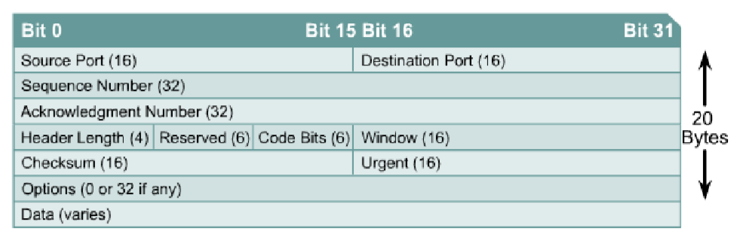
TCP - Header Format
TCP uses only a single type of protocol data unit, called a TCP segment
The following protocols use TCP.
FTP
HTTP
SMTP
Telnet

Slide 37
TCP Segment – Definition of the fields
Source port : Number of the port that sends data
Destination port : Number of the port that receives data
Sequence number : Number used to ensure the data arrives in the correct order
Acknowledgement number : Next expected TCP octet
HLEN : Number of 32-bit words in the header
Reserved : Set to Zero
Code bits : Control functions, such as setup and termination of a session
Window : Number of octets that the sender will accept
Checksum : Calculated checksum of the header and data fields
Urgent Pointer : Indicates the end of the urgent data
Option : One option currently defined, maximum TCP segment size
Data : Upper-layer protocol data

Slide 38
Code bits or Flags (6bits)
URG : urgent pointer field indication
ACK : Acknowledgement field significant
PSH : Push function
RST : Reset the connection
SYN : Synchronize the sequence numbers
FIN : No more data from sender

Slide 39
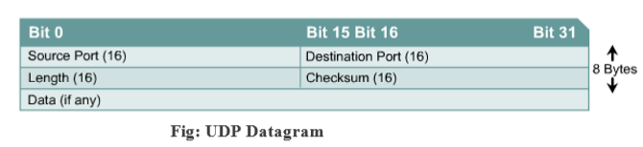
UDP – User Datagram Protocol
UDP is the connectionless transport protocol in the TCP/IP Protocol stack
UDP is a simple protocol that exchanges datagrams without guaranteed delivery
It relies on higher-layer protocols to handle errors and retransmit data
UDP does not use windows or ACKs
Reliability is provided by application layer protocols. UDP is designed for applications that do not need to put sequences of segments together
The following protocols use UDP
TFTP
SNMP
DHCP
DNS

Slide 40
UDP Datagram – Definitions of fields
Source port – Number of the port that sends data
Destination port – Number of the port that receives data
Length – Number of bytes in header and data
Checksum – Calculated checksum of the header and data fields
Data – Upper-layer protocol data

Slide 41
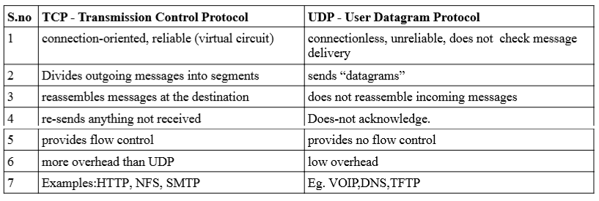
TCP vs UDP

Slide 42
Internet Layer
The purpose of the Internet layer is to select the best path through the network for packets to travel
The main protocol that functions at this layer is IP(Internet Protocol)
Best path determination and packet switching occur at this layer
Protocols that operate at TCP/IP Internet layer:
IP : provides connectionless, best-effort delivery routing of packets. IP is not concerned with the content of the packets but looks for a path to the destination
Internet Control Message Protocol(ICMP) : Provides control and messaging capabilities
Address Resolution Protocol(ARP) : determines the data link layer address, or MAC address, for known IP addresses
Reverse Address Resolution Protocol(RARP) : determines the IP address for a known MAC address
IP performs the following operations :
Defines a packet and an Addressing Scheme
Transfers data between the Internet layer and network access layer
Routes packets to remote hosts

Slide 43
Network Access Layer:
The network access layer allows an IP packet to make a physical link to the network media
It includes the LAN and WAN technology details and all the details contained in the OSI physical and data link layers
Drivers for software applications, modem cards, and other devices operate at the network access layer
The network access layer defines the procedures used to interface with the network hardware and access the transmission medium
Modem protocol standards such as Serial Line Internet Protocol (SLIP) and Point-to-Point Protocol (PPP) provide network access through a modem connection
Many protocols are required to determine the hardware, software, and transmission-medium specifications at this layer
Network access layer protocols also map IP addresses to physical hardware addresses and encapsulate IP packets into frames
The network access layer defines the physical media connection based on the hardware type and network interface

Slide 44
Comparison of OSI and TCP/IP Model:
Similarities
Both have layers
Both have application layers, though they include different services
Both have comparable transport and network layers
Both use packet-switched instead of circuit-switched technology
Networking professionals need to know both models
Differences
TCP/IP combines the OSI application, presentation, and session layers into its application layer
TCP/IP combines the OSI data link and physical layers into its network access layer
TCP/IP appears simpler because it has fewer layers
When the TCP/IP transport layer uses UDP it does not provide reliable delivery of packets. The transport layer in the OSI model always does
The internet was developed based on the on the standards of the TCP/IP protocols
The TCP/IP model gains credibility because of its protocols
The OSI model is not generally used to build networks
The OSI model is used as a guide to help students understand the communication process

